Slide 1


Fertility Insights: Data-Driven IVF Monitoring
Prepared by: Janagam Teja

Slide 2
Contents
Business Objective
Business Constraints
Project Architecture - Data Flow Diagram
Data Collection
Exploratory Data Analysis
Data Visualization
Notes:
Change

Slide 3
Business Problem
Rising stress and lifestyle changes have increased IVF demand by 20–30% globally, but overall IVF success rates remain low at 30–35% per cycle. A major contributor is the 25–40% inter-observer variability in embryo grading between embryologists, which leads to inconsistent embryo selection and up to 15–20% loss in implantation potential. Additionally, patients often receive definitive outcome clarity only after 3–4 months, creating delays in clinical decisions and lowering patient satisfaction. These inefficiencies collectively lead to an estimated 10–15% increase in operational cost per cycle and reduce clinic-wide performance visibility across stakeholders.
High Level Solution : Analyzing historical embryo grades, prediction scores and implantation outcomes to identify key success indicators.
Business Objective : Maximize the success rate of ART Procedures.
Business Constraint : Minimize the treatment cost.
Business Success Criteria : Increase the success rate of ART procedures by at least 10% . Economic Success Criteria : Achieve a cost saving of at least 25% by reducing the expenditure on working with embryos of lower grading.

Slide 4
Project Overview and Scope
Project Overview:
This project analyzes historical IVF data to identify:
Success factors
Risk indicators
Cost drivers
Treatment effectiveness
Scope:
Analysis of 6 interconnected datasets.
Covers entire IVF journey:
Patient profile
Hormonal response
IVF lab performance
Treatment strategy comparison
Neonatal outcomes
Biomarker intelligence
Out of Scope:
Predictive ML models
Genetic diagnosis
Live clinical intervention

Slide 5
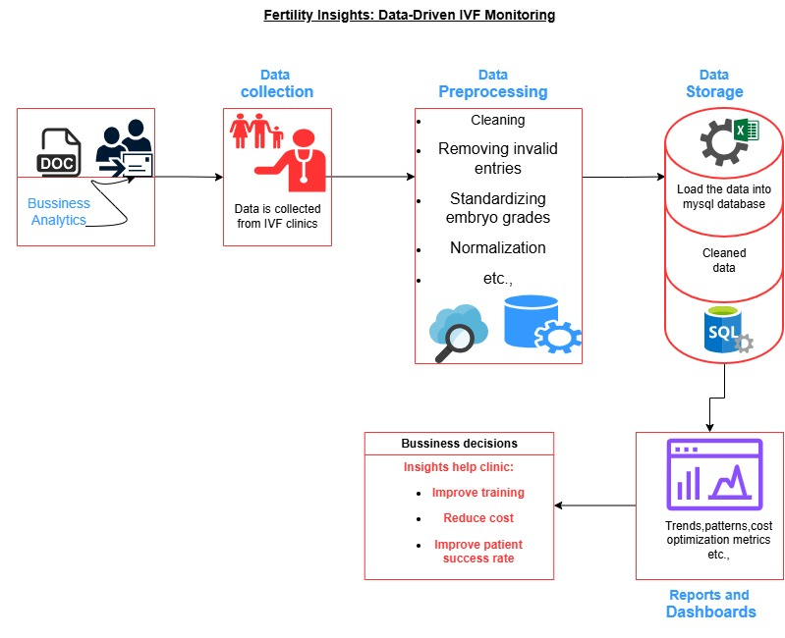
Project Architecture - Data Flow Diagram
Notes:
Keep observations

Slide 6
Data Collection
Data was collected from:
IVF clinical records
Lab and embryology reports
Neonatal outcome records
Biomarker test results (BMP15, LIF)
All datasets were:
De-identified
Stored in SQL database
Pre-Processed and cleaned the datasets
Imported into Power BI for analysis
Notes:
Add graphical

Slide 7
Data Dictionary
Column Name | Description | Data Type | Unit / Values | Relevance
patient_name_and_surname | Patient identifier (anonymized) | Text | — | Low
age | Female patient age | Numeric | Years | High
spouse_age | Male partner age | Numeric | Years | Medium
clinical_pregnancy | Clinical pregnancy outcome | Binary | 1 = Yes, 0 = No | High
live_birth | Live birth outcome | Binary | 1 = Yes, 0 = No | High
week_of_birth | Gestational age at birth | Numeric | Weeks | Medium
neonatal_death | Neonatal death indicator | Binary | 1 = Yes, 0 = No | Medium
abortion | Pregnancy loss indicator | Binary | 1 = Yes, 0 = No | High
bhcg_12 | β-hCG level on Day 12 | Numeric | IU/L | High
bhcg_14 | β-hCG level on Day 14 | Numeric | IU/L | High
bhcg_12_14percent_increase | % increase in β-hCG | Numeric | % | High
twin | Twin pregnancy indicator | Binary | 1 = Yes, 0 = No | Medium
indication | Cause of infertility | Categorical | Hormonal, Male, etc. | High
fsh | Follicle-stimulating hormone | Numeric | IU/L | High
e2 | Estradiol level | Numeric | pmol/L | High
progesterone | Progesterone level | Numeric | ng/mL | High
number_of_oocytes | Eggs retrieved | Numeric | Count | High
embryo_tranfer_day | Day of embryo transfer | Numeric | Day 3 / Day 5 | Medium
endometrial_thickness_on_the_day_of_transfer | Endometrial lining thickness | Numeric | mm | High
number_of_embryos_transferred | Embryos transferred | Numeric | Count | High
amh | Anti-Müllerian Hormone | Numeric | ng/mL | High

Slide 8
Data Dictionary
Dataset-2
Column Name | Description | Data Type | Unit | Relevance
fc_no | Fertility center ID | Text | — | Low
cycle_no | IVF cycle number | Numeric | Count | Medium
age | Patient age | Numeric | Years | High
duration_of_infertility | Infertility duration | Numeric | Years | Medium
bmi | Body Mass Index | Numeric | kg/m² | High
protocol | Stimulation protocol used | Categorical | Long/Antagonist | High
days_of_stimulation | Duration of stimulation | Numeric | Days | High
e2_on_trigger_day | Estradiol on trigger day | Numeric | pmol/L | High
total_oocytes | Total oocytes retrieved | Numeric | Count | High
m2_oocytes | Mature oocytes | Numeric | Count | High
embryos_formed | Embryos developed | Numeric | Count | High
blast_y_n | Blastocyst formed | Binary | Yes/No | High
good_blast | Good-quality blastocyst | Binary | Yes/No | High
ivf_success | IVF success outcome | Binary | 1 = Success | High

Slide 9
Data Dictionary
Dataset-3
Column Name | Description | Data Type | Unit | Relevance
age_(in_years) | Patient age | Numeric | Years | High
body_mass_index_(bmi) | BMI | Numeric | kg/m² | High
parity | Number of previous births | Numeric | Count | Medium
is_menses_regular | Menstrual regularity | Categorical | Yes/No | Medium
serum_fsh_value_(in_iu/l) | Serum FSH level | Numeric | IU/L | High
serum_amh_value_(in_pmol/l) | Serum AMH level | Numeric | pmol/L | High
number_of_oocytes_retrieved | Oocytes retrieved | Numeric | Count | High
method_of_fertilization | IVF / ICSI | Categorical | IVF/ICSI | High
quality_of_embryo_used | Embryo quality | Categorical | Good/Average | High
pregnancy_outcome | Pregnancy result | Categorical | Live birth, loss | High
ivf_success | IVF success flag | Binary | 1 = Success | High
how_do_you_feel_about_the_ivf_experience | Patient feedback | Categorical | Satisfied, Neutral | Medium

Slide 10
Data Dictionary
Dataset-4
Column Name | Description | Data Type | Unit | Relevance
group1_chm_2_non_chm | Treatment group | Categorical | 1=CHM, 2=Non-CHM | High
ageyear | Patient age | Numeric | Years | High
bmikg_m2 | BMI | Numeric | kg/m² | High
dose_of_gniu | Gonadotropin dose | Numeric | IU | High
duration_of_gnd | Stimulation duration | Numeric | Days | High
retrieved_oocytes | Eggs retrieved | Numeric | Count | High
fertilizationpercent | Fertilization rate | Numeric | % | High
good_quality_embryopercent | Good embryo % | Numeric | % | High
clinical_pregnancy | Clinical pregnancy | Binary | 1 = Yes | High
miscarriage | Miscarriage indicator | Binary | 1 = Yes | High
live_birth | Live birth outcome | Binary | 1 = Yes | High
pregnancy_success | Final success flag | Binary | 1 = Success | High

Slide 11
Data Dictionary
Dataset-5
Column Name | Description | Data Type | Unit | Relevance
group1=chm_2=non_chm | Treatment group | Categorical | CHM / Non-CHM | High
weightkg | Baby birth weight | Numeric | kg | High
apgar | APGAR score | Numeric | 0–10 | High
gender_label | Baby gender | Categorical | Male/Female | Low
delivery_occurred | Delivery confirmation | Binary | Yes/No | Medium
Dataset-6
Column Name | Description | Data Type | Unit | Relevance
group1=chm_2=non_chm | Treatment group | Categorical | CHM / Non-CHM | High
bmp15pg_ml | BMP15 biomarker (egg quality) | Numeric | pg/mL | High
lifpg_ml | LIF biomarker (implantation) | Numeric | pg/mL | High
group_label | Group name | Text | CHM / Non-CHM | High
Notes:
Add graphical

Slide 12
Exploratory Data Analysis [EDA]
Table 1: Clinical & Hormonal Data
Statistical Insights
Business Insights
• IVF success decreases with increasing maternal age • Higher AMH is associated with higher oocyte retrieval • Rising BHCG levels (Day 12–14) strongly predict pregnancy • Optimal endometrial thickness improves implantation
• Age-based risk stratification helps improve treatment planning • Early AMH assessment enables better ovarian response prediction • BHCG trend analysis provides faster outcome clarity • Optimizing endometrial thickness improves embryo transfer success
Notes:
EDA is used for seeing what the data can tell us before the modeling task.
Change

Slide 13
Exploratory Data Analysis [EDA]
Table 2: IVF Cycle & Lab Performance
Statistical Insights
Business Insights
• Significant drop observed from retrieved oocytes to embryos • Fertilization and blast formation vary by stimulation protocol • Higher M2 oocyte count improves embryo formation • Not all IVF cycles reach blast stage
• Identifies inefficiencies in IVF lab workflow • Helps optimize stimulation and fertilization protocols • Focus on oocyte maturity improves lab success rates • Early cycle screening reduces wasted lab effort and cost
Notes:
EDA is used for seeing what the data can tell us before the modeling task.
Change

Slide 14
Exploratory Data Analysis [EDA]
Table 3: Patient Journey & Risk Factors
Statistical Insights
Business Insights
• IVF success declines with increasing age and BMI • Higher AMH correlates with better IVF outcomes • Irregular menses is associated with lower success • Multiple IVF attempts increase failure probability
• Risk-based counselling improves patient transparency • Early success estimation builds patient trust • Personalized treatment planning improves outcomes • Managing expectations improves patient satisfaction
Notes:
EDA is used for seeing what the data can tell us before the modeling task.
Change

Slide 15
Exploratory Data Analysis [EDA]
Table 1A: CHM vs Non-CHM
Statistical Insights
Business Insights
• CHM group shows better embryo quality • CHM requires lower gonadotropin dosage • Live birth rates are comparable or higher in CHM • CHM shows shorter stimulation duration
• Supports standardization of cost-effective CHM protocol • Lower drug usage helps reduce overall treatment cost • Maintains success rates without compromising safety • Improves operational efficiency and patient comfort
Notes:
EDA is used for seeing what the data can tell us before the modeling task.
Change

Slide 16
Exploratory Data Analysis [EDA]
Table 1B: Neonatal Outcomes
Statistical Insights
Business Insights
• Majority of babies have normal birth weight • APGAR scores are within healthy range • No abnormal gender distribution observed • Delivery outcomes are consistent across treatments
• Confirms IVF success leads to healthy babies • Ensures neonatal safety of treatment protocols • Maintains ethical and clinical balance • Strengthens clinic quality and reputation
Notes:
EDA is used for seeing what the data can tell us before the modeling task.
Change

Slide 17
Exploratory Data Analysis [EDA]
Table 1C: Biomarker Analysis
Statistical Insights
Business Insights
• Higher BMP15 indicates better egg quality • Higher LIF indicates better implantation readiness • CHM group shows favorable biomarker levels • Biomarkers provide early biological success signals
• Enables early identification of high-potential cycles • Reduces low-probability embryo transfers • Supports biologically effective treatment selection • Helps reduce cost and improve success rates
Notes:
EDA is used for seeing what the data can tell us before the modeling task.
Change

Slide 18
Data Preprocessing
Key preprocessing steps:
Column renaming & standardization
Handling missing and null values
Creating derived columns (age groups, BMI groups)
Converting flags to binary indicators
Ensuring correct data types
Tools used:
SQL
Python
Power BI Power Query
Notes:
Keep observations

Slide 19
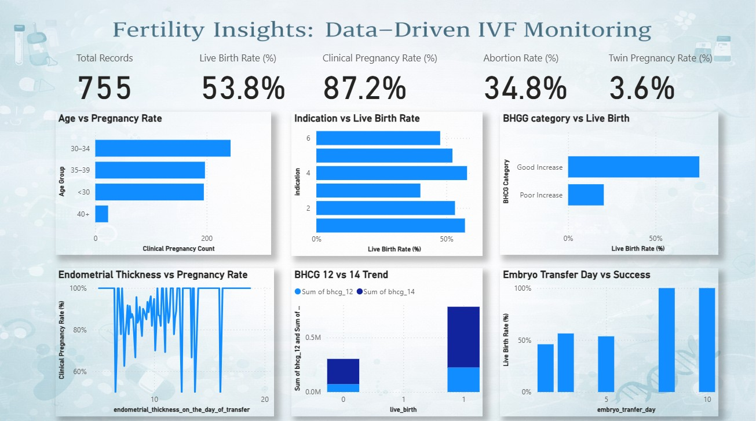
Data Visualization
Notes:
Add graphical

Slide 20
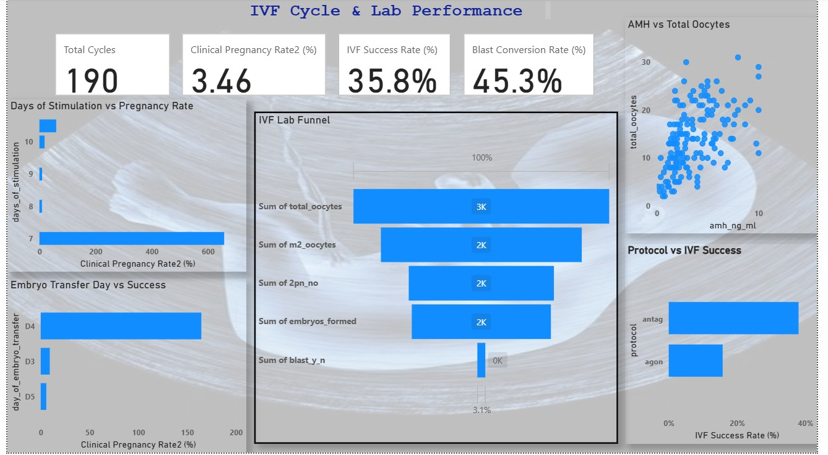
Data Visualization
Notes:
Add graphical

Slide 21
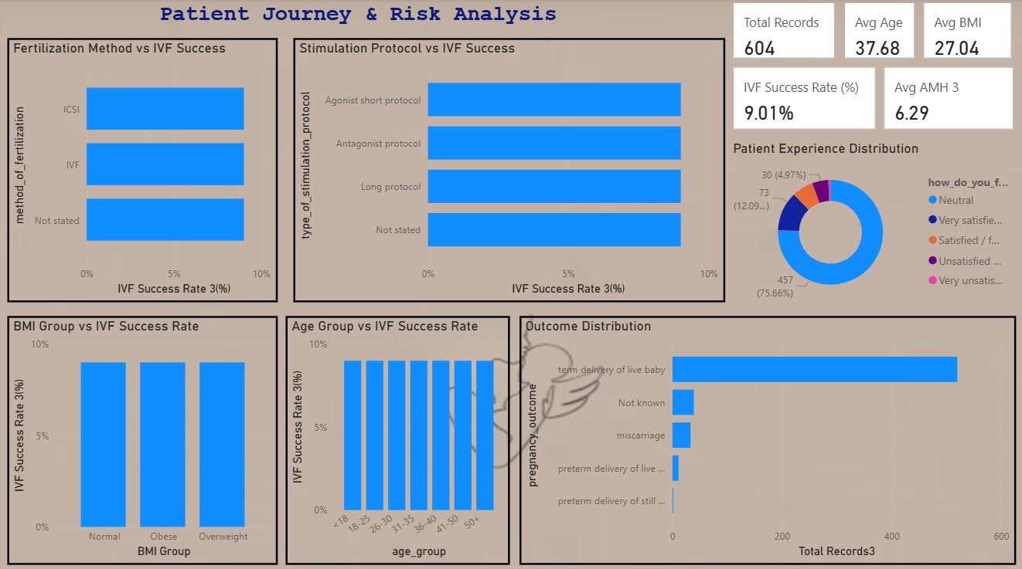
Data Visualization
Notes:
Add graphical

Slide 22
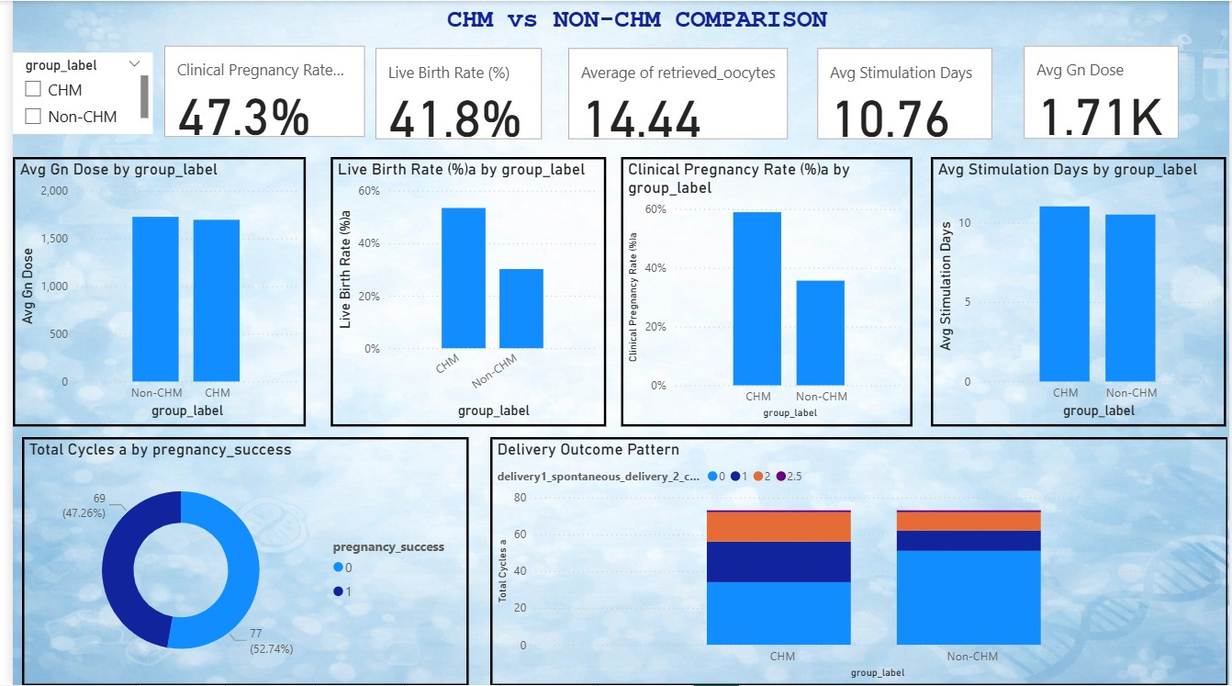
Data Visualization
Notes:
Add graphical

Slide 23
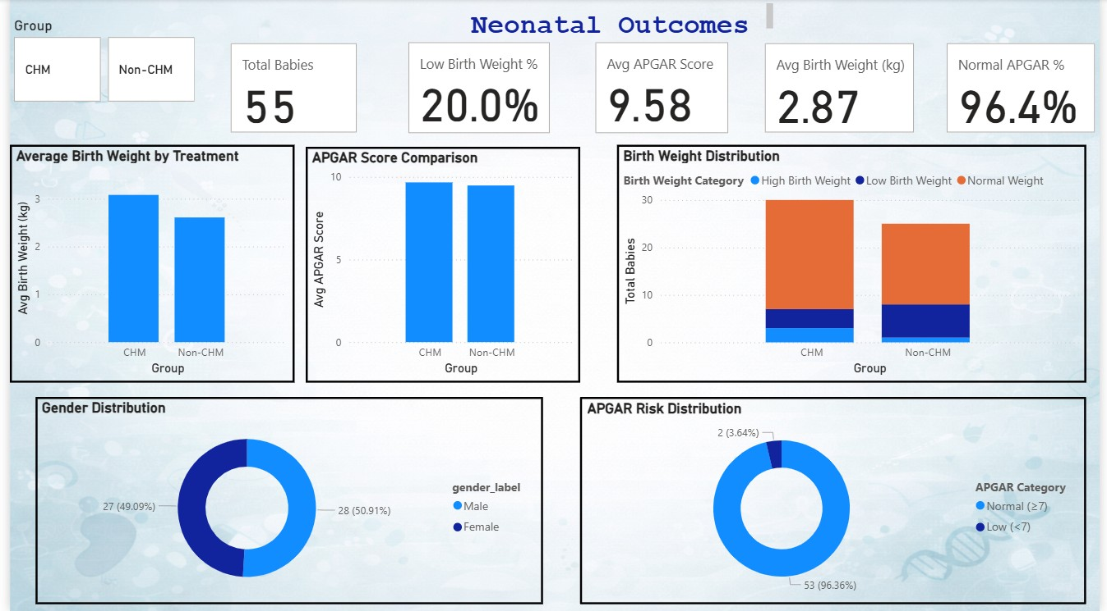
Data Visualization
Notes:
Add graphical

Slide 24
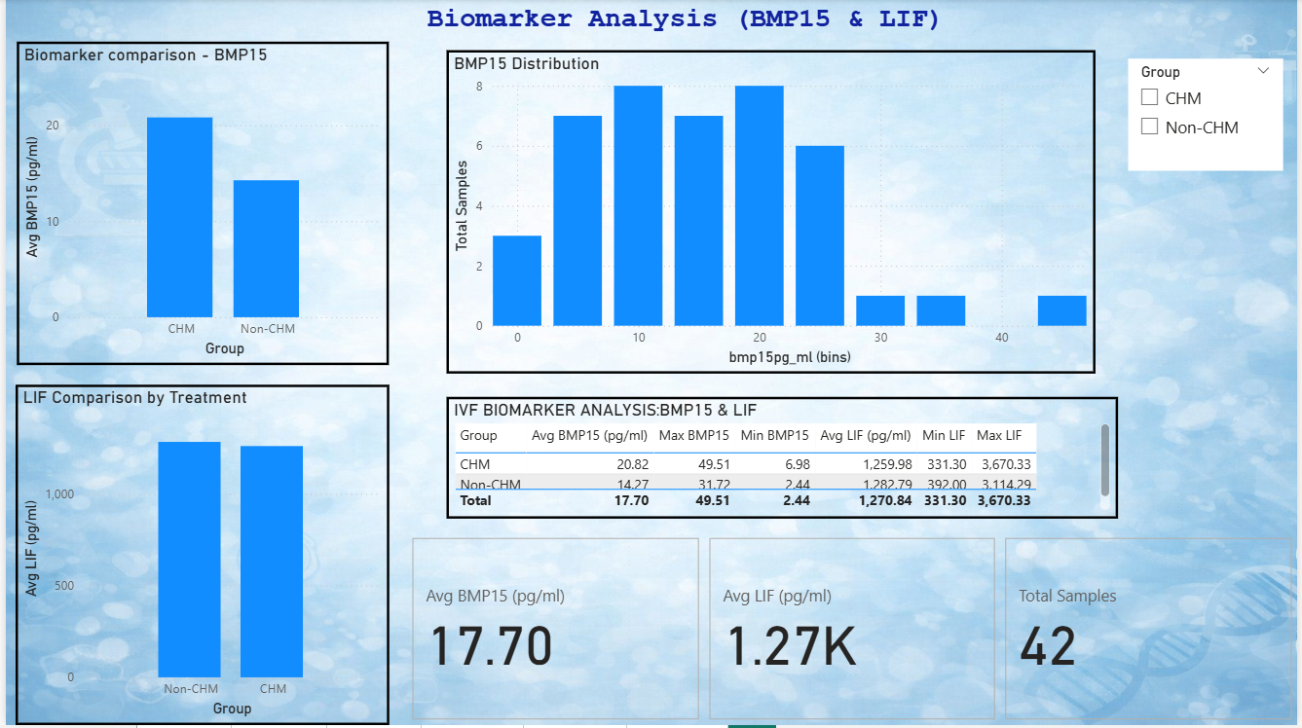
Data Visualization
Notes:
Add graphical

Slide 25


